Slide 1



Introduction to OR

Slide 2
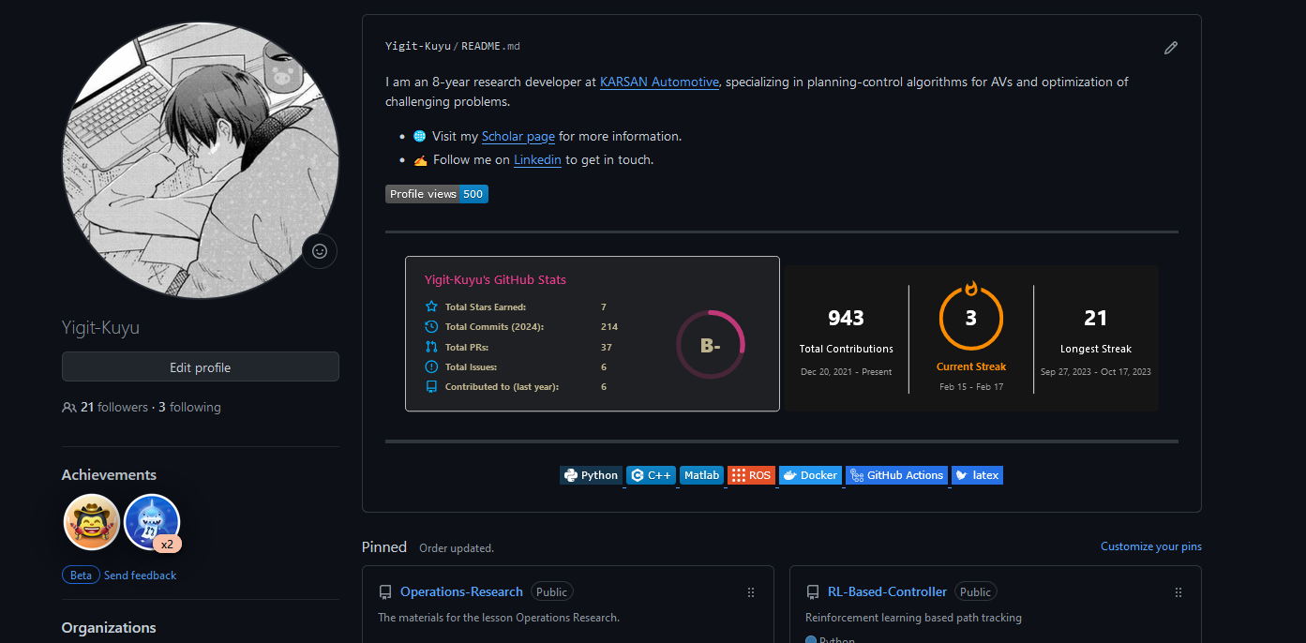
Related Repo

Slide 3
What is OR?
Operations research is a multidisciplinary field that deals with the application of advanced analytical methods to help make better decisions. Operational Research always tries to find the best and optimal solution to the problem.
The British/Europeans refer to "operational research", the Americans to "operations research" - but both are often shortened to just ‘OR’.

Slide 4
The Methodology of OR
Step 1. Define the Problem of Interest and Gather Relevant Data
Clarification of Objectives: Identify the primary goal(s) of the optimization problem. This could involve minimizing costs, maximizing profits, improving efficiency, or enhancing service quality. Clear objectives guide the formulation of the mathematical model.
Data Collection: Gather accurate and relevant data that impacts the problem. This includes quantitative data (e.g., costs, capacities, demand levels) and qualitative insights (e.g., regulatory constraints, stakeholder preferences). The quality of the solution depends heavily on the accuracy and completeness of this data.
Step 2. Formulate a Mathematical Model to Represent the Problem
Variable Identification: Determine the decision variables that the solution can adjust. These variables represent the choices available to solve the problem.
Constraints Specification: Identify the constraints that limit the decision variables. Constraints could be physical capacities, budget limitations, legal requirements, or any other restrictions.
Objective Function: Develop an objective function that needs to be maximized or minimized. This function quantifies the goal of the optimization problem in terms of the decision variables.

Slide 5
The Methodology of OR
Step 3. Develop a Computer-based Procedure for Deriving Solutions to the Problem from the Model
Algorithm Selection: Choose or develop computational algorithms that can find optimal or near-optimal solutions. This might involve linear programming, integer programming, simulation, or heuristic methods, depending on the problem's complexity and nature.
Implementation: Code the model and the solving procedure using appropriate software tools such as MATLAB, Python (with libraries like NumPy, SciPy, or PuLP), C++, or specialized software like LINGO, CPLEX, or Gurobi.
Step 4. Test the Model and Refine It as Needed
Validation: Check the model's accuracy by comparing its predictions with real-world outcomes or established benchmarks. This step ensures the model's assumptions and simplifications are reasonable.
Sensitivity Analysis: Analyze how sensitive the solution is to changes in the model's parameters. This helps understand the impact of uncertainty in data and assumptions on the final decision.

Slide 6
The Methodology of OR
Step 5. Implement
Execution of Solution: Apply the model's solution to the real-world problem. This may involve adjusting schedules, reallocating resources, changing operational strategies, etc.
Monitoring and Feedback: Continuously monitor the outcomes of the implementation, and collect feedback to identify any discrepancies, unforeseen issues, or areas for improvement.
Additional Considerations
Model Updating: Over time, changes in the external environment, internal processes, or data accuracy may necessitate updates to the model to keep it relevant and effective.
Ethical and Social Considerations: Consider the broader impacts of optimization decisions on society, the environment, and ethical norms, aiming for sustainable and responsible outcomes.

Slide 7
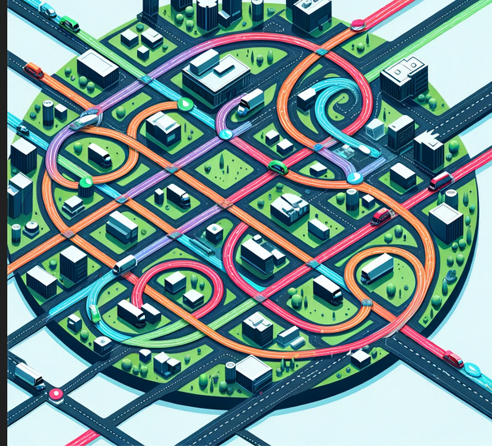
Specific type of OR Problems
•Vehicle Routing Problem (VRP)
The Vehicle Routing Problem involves determining the optimal routes for a fleet of vehicles to deliver goods or services to a set of customers, starting and ending at a depot, while minimizing total distance traveled, cost, or time.

Slide 8
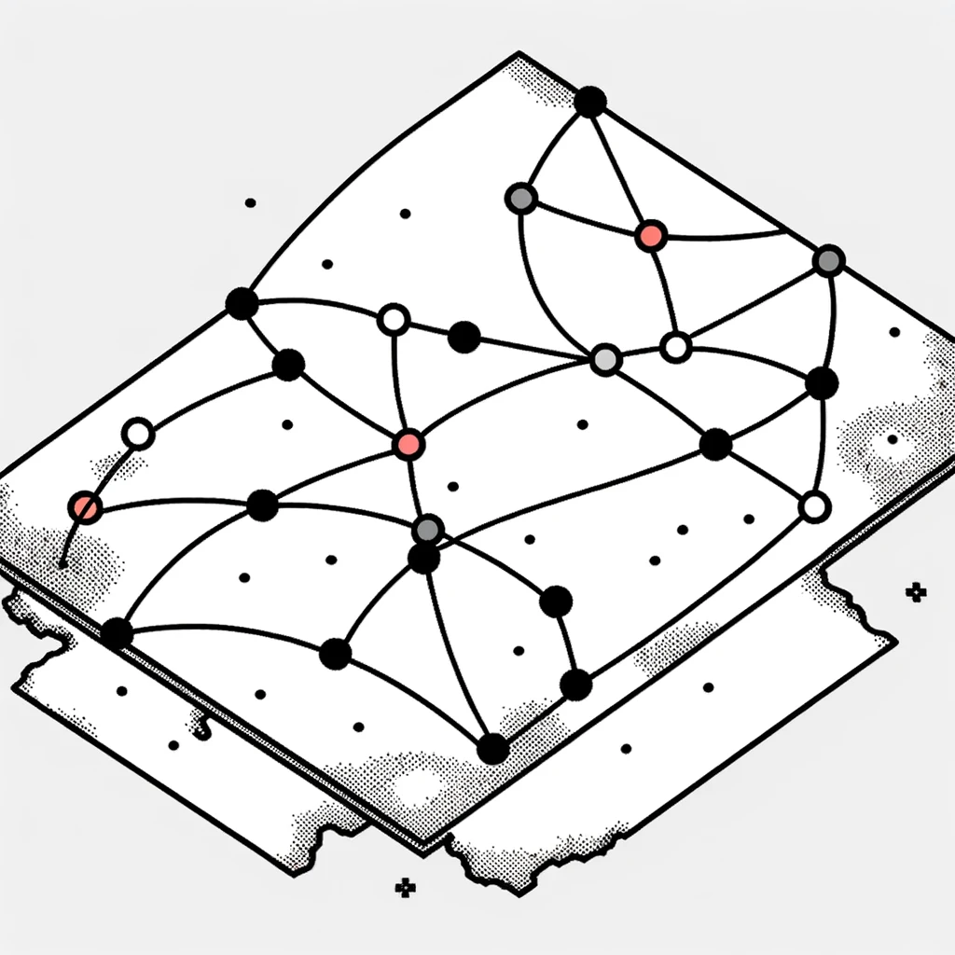
Specific type of OR Problems
Traveling Salesman Problem (TSP)
The Traveling Salesman Problem asks for the shortest possible route that visits a set of cities exactly once and returns to the origin city.

Slide 9
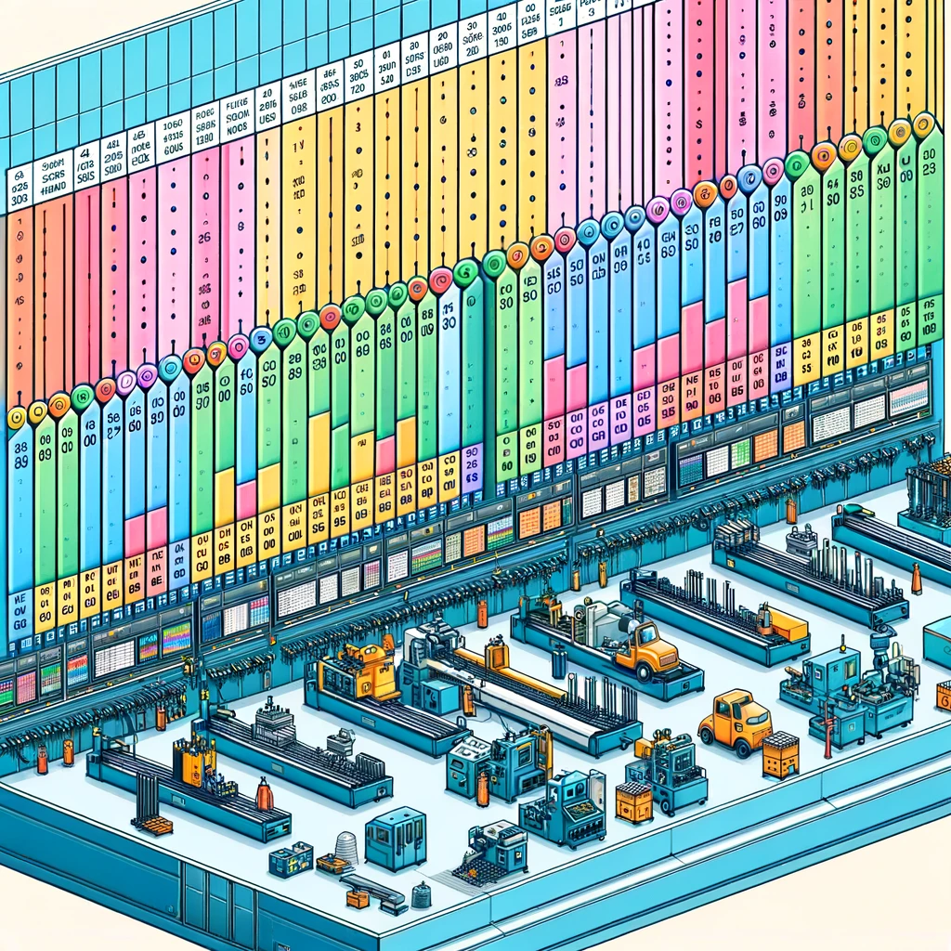
Specific type of OR Problems
Job Shop Scheduling (JSS)
Job Shop Scheduling involves scheduling jobs on machines or production facilities, where each job consists of a sequence of tasks that need to be performed on specific machines in a particular order. The objective often is to minimize the total time needed to complete all jobs (makespan), optimize machine utilization, or minimize job tardiness.

Slide 10

Specific type of OR Problems
Knapsack Problem
The Knapsack Problem involves selecting items from a set, each with a weight and a value, to include in a knapsack so that the total weight is less than or equal to a given limit and the total value is maximized. It has applications in resource allocation, budget management, and in constructing portfolios in finance.

Slide 11

Specific type of OR Problems
Facility Location Problem
This problem focuses on finding the best locations for facilities (warehouses, factories, fire stations, etc.) to minimize transportation costs, serve customer demand efficiently, or maximize coverage. It's fundamental in supply chain design, urban planning, and logistics.

Slide 12

Specific type of OR Problems
Network Design
Network Design problems involve configuring a network (e.g., telecommunications, transportation, or logistics networks) to meet certain criteria, such as minimizing cost, maximizing capacity, or optimizing flow. This can include determining the locations of nodes, the paths between them, and the capacity of each link.

Slide 13

Specific type of OR Problems
Inventory Management Problems
These problems deal with determining the optimal order quantity and reorder points for inventory to minimize holding, ordering, and shortage costs. This is critical for efficient supply chain management, reducing operational costs, and ensuring product availability.

Slide 14
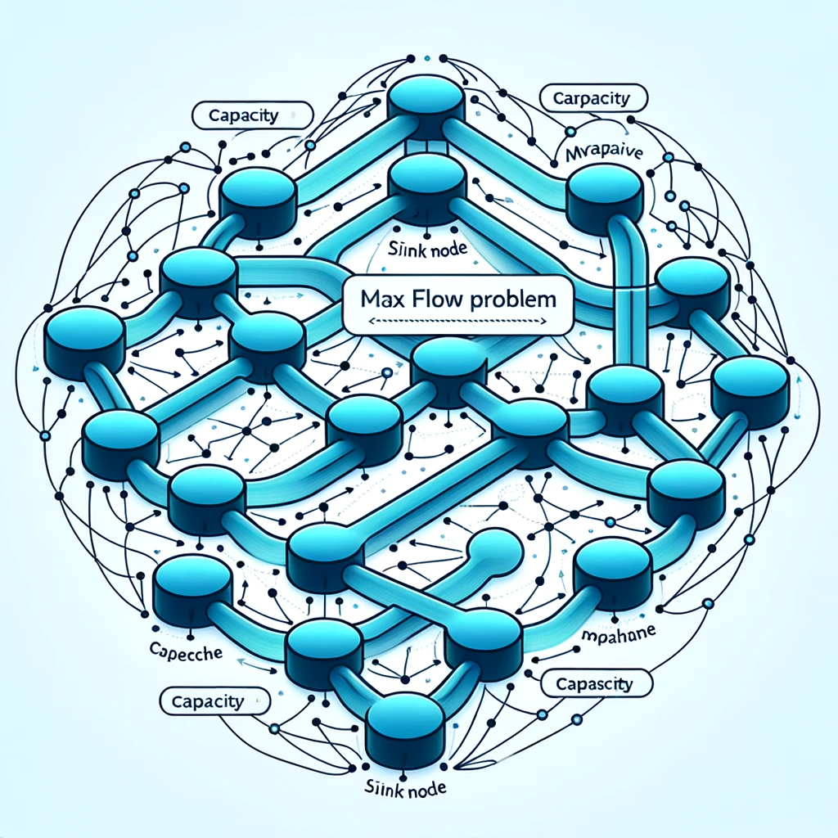
Specific type of OR Problems
Max Flow Problem
The Maximum Flow problem aims to find the maximum amount of flow that can be sent from a source to a sink in a flow network, such that the flow through any edge does not exceed its capacity. It's applicable in traffic management, network design, and resource allocation.

Slide 15
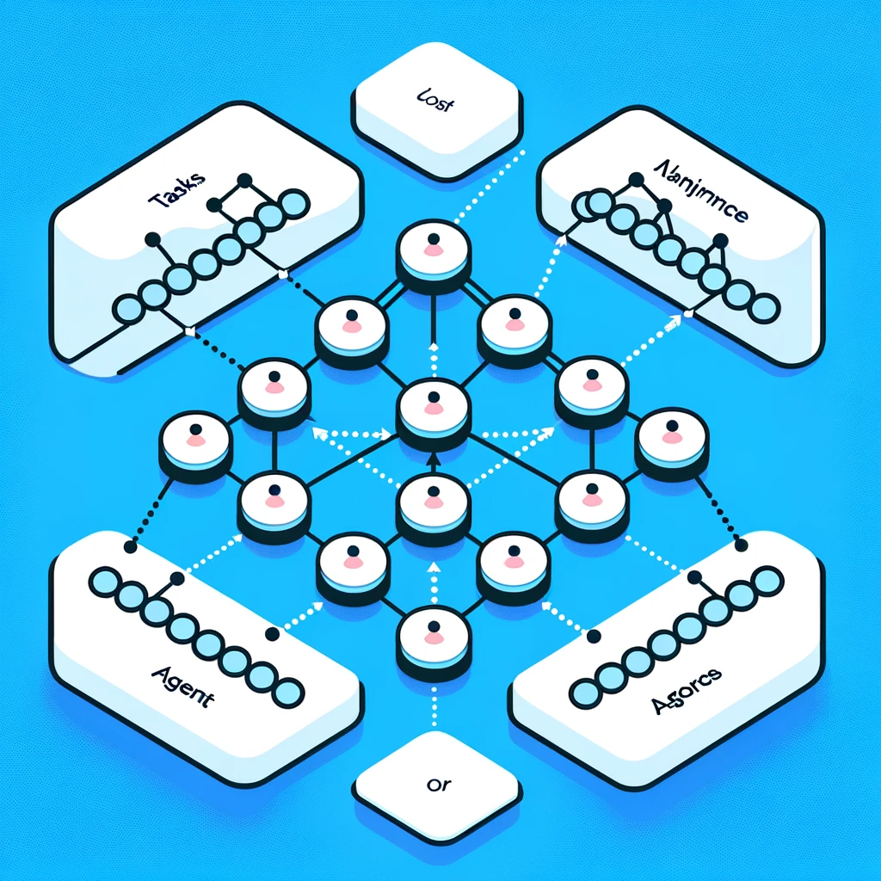
Specific type of OR Problems
Assignment Problem
The Assignment Problem involves assigning a set of tasks to a set of agents in the best way possible, such as minimizing total costs or maximizing efficiency. Applications include task assignment in project management, assigning employees to jobs, and allocating resources in production processes.

Slide 16
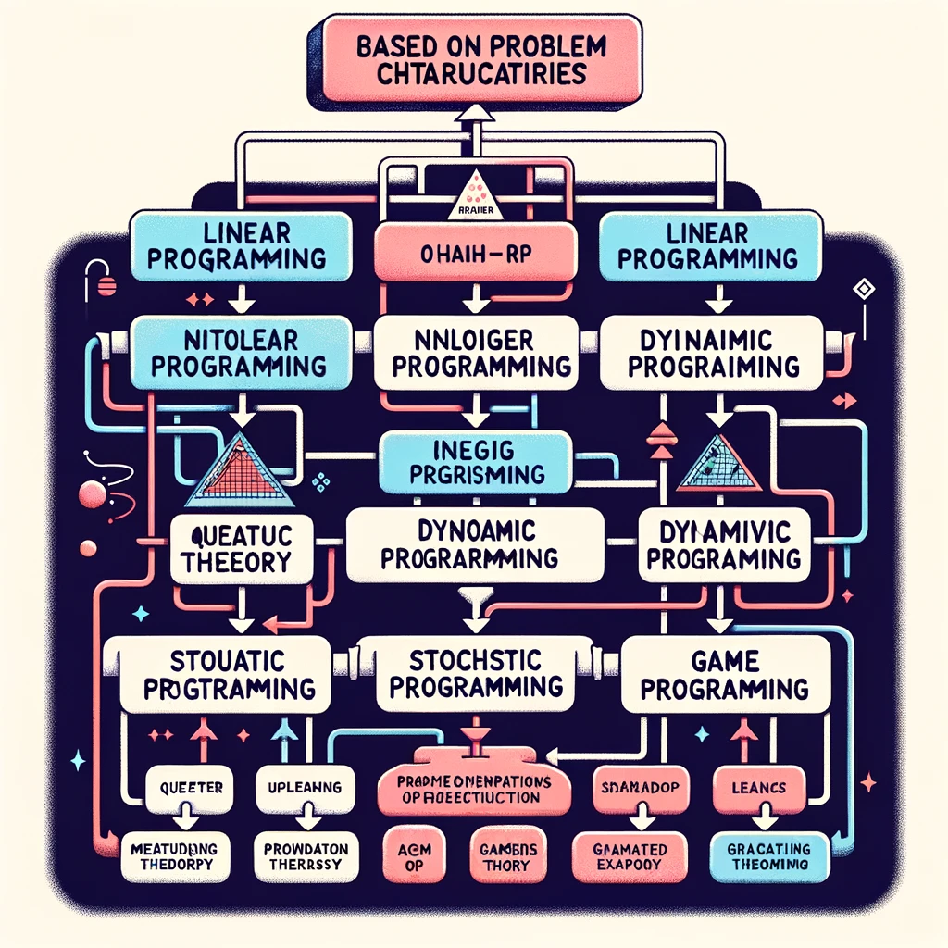
OR Diagram

Slide 17
OR History
1930s-1940s (Military Origins during World War II): Operations Research (OR) originated in the military efforts of World War II, where teams of scientists applied scientific methods to optimize military operations. This period is symbolized by strategic maps representing problems like the Vehicle Routing Problem (VRP).
1950s-1960s (Expansion into Civilian Applications): In the post-war era, OR expanded into civilian sectors, applying its principles to industrial manufacturing and logistics. Icons such as gears for Job Shop Scheduling (JSS) and boxes for Inventory Management symbolize this transition.

Slide 18
OR History
1970s-1990s (Rise of Computational OR and Software): The advent of computers transformed OR, enabling the solution of complex problems through computational methods and software, highlighted by a computer and code symbols. This period also saw the integration of Metaheuristics under Stochastic Programming.
20th Century (Development of Core Methodologies): This era marked the development of foundational OR methodologies, including Linear Programming (LP), Nonlinear Programming (NLP), and Integer Programming (IP). Mathematical symbols represent these significant advancements.

